Slide 1
Describing Motion with Words Notes

Slide 2
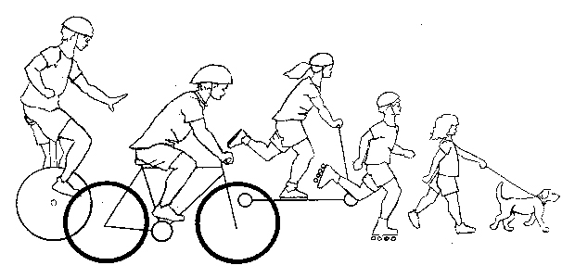
Using Words to Describe Motion
We’ve all used to describe motion such as going fast, stopped, slowing down, speeding up, and turning.
We will be expanding upon this vocabulary list with words such as distance, displacement, speed, velocity, and acceleration.

Slide 3

Kinematics is the science of describing the motion of objects using words, diagrams, numbers, graphs, and equations.
The goal of any study of kinematics is to develop sophisticated mental models which serve to describe (and ultimately, explain) the motion of real-world objects.

Slide 4
Scalars and Vectors
Scalars are quantities which are fully described by a magnitude (or numerical value) alone.
Vectors are quantities which are fully described by both a magnitude and a direction.

Slide 5
Practice
Scalar or Vector?
5 m
30 m/sec East
5 mi. North
20 degrees Celsius
256 bytes
4000 Calories

Slide 6
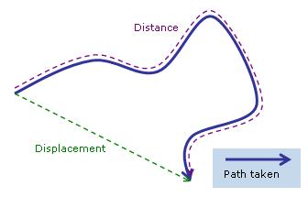
Distance and Displacement
Distance is a scalar quantity which refers to "how much ground an object has covered" during its motion.
Displacement is a vector quantity which refers to "how far out of place an object is"; it is the object's overall change in position.

Slide 7
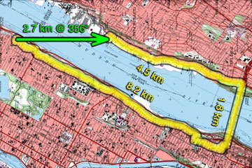
Practice
What is the displacement of the cross-country team if they begin at the school, run 10 miles and finish back at the school?
What is the distance and displacement for the diagram?

Slide 8
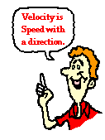
Speed and Velocity
Speed is a scalar quantity which refers to "how fast an object is moving." Speed can be thought of as the rate at which an object covers distance.
Velocity is a vector quantity which
refers to "the rate at which an
object changes its position."

Slide 9
Calculations
Average speed = distance / time
Average velocity = displacement / time

Slide 10
Algebra Practice
Speed = distance / time
Solve for time:
Time = distance / speed

Slide 11
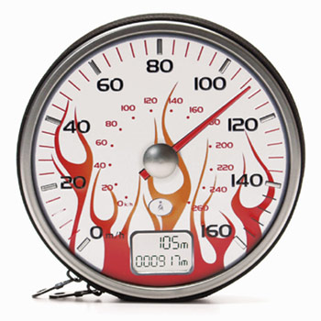
Instantaneous vs. Average Speed
Instantaneous Speed - the speed at any given instant in time.
Average Speed - the average of all instantaneous speeds; found simply by a distance/time ratio.

Slide 12
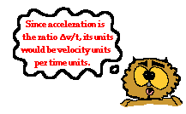

Acceleration
Acceleration is a vector quantity which is defined as the rate at which an object changes its velocity. An object is accelerating if it is changing its velocity.
Acceleration =
change in velocity / time

Slide 13
Galileo 2 Logger Pro Set-up
Adjust the photo gate. Move it up the ramp until the light is red, slide it down until the red light is off.
You will adjust the distance by adjusting where you release the ball, do not move the photo gate once set-up is complete.
To collect data you’ll use the computer and a stop watch at the same time. The computer will give the velocity data. The stop watch will be used for the time data.
To begin, click the green collect arrow on the computer, click erase and continue, place the marble in place, release and start timer (be sure to catch the marble!)
The collection period has a time limit, you’ll get about two data points before it times off
To continue collection, click the green, collect button.
When done, log off the computer.
Clean-up – listen to directions from your instructor, you maybe leaving the set-up constructed for the next class or breaking down the set-up into bins.
Turn on the computer (it may already be on).
Set-up ramp.
Attach photo gate to the ring stand using a clamp (this may already be done for you).
Set photo gate near the end of the ramp (be sure it is securely on the table).
Attached the cable to the photo gate and green Logger Pro.
Attach the USB cable to the computer and the other end to the Logger Pro.
Attach the Power Adapter to the Logger Pro (it should make noise…if not double check all cables are tight).
Open the instructor’s website, under the Vernier Links open the computer file for the Galileo 2 Lab.
At this point Logger Pro should be open, you should see a green collect button on near the top (if you do not, ask your instructor for help).

